Slide 1
The Internet is For Everyone
Unit 1- Lesson 8

Slide 2

Review
Review Quiz- Unit 1 Lessons 1-7
Journal Check End of Week

Slide 3
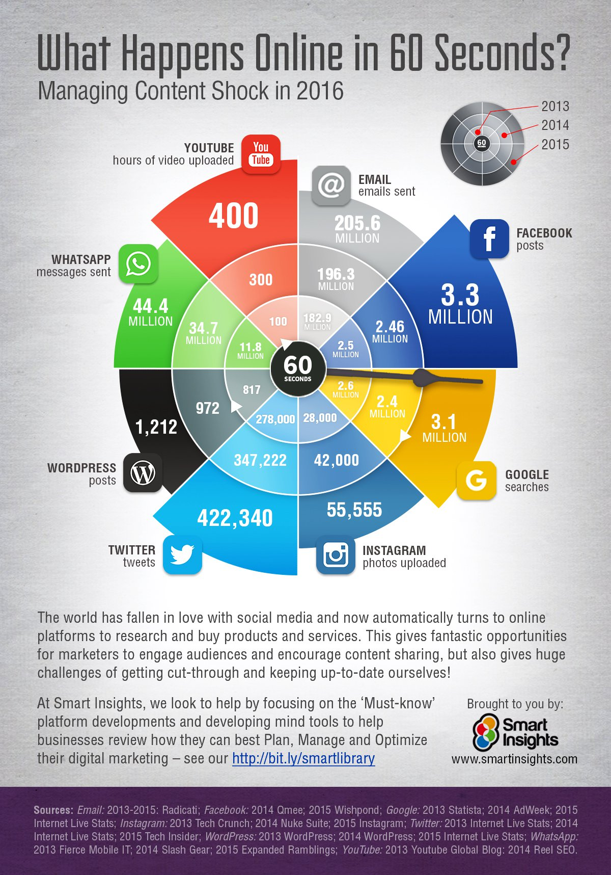

Slide 4
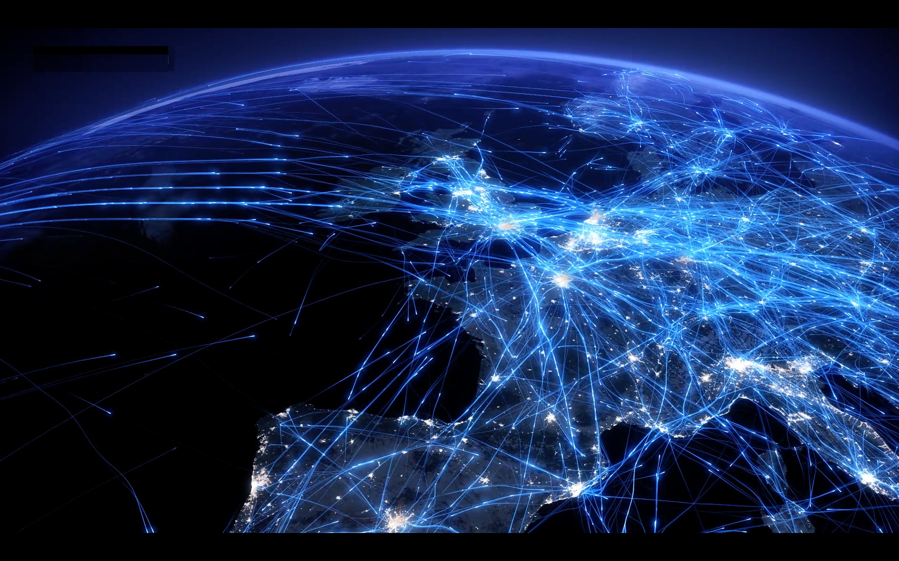
Lesson 8: The Internet Is for Everyone
So far in this class you have solved a few problems by creating and using small protocols for transmitting data over a wire to one other person
But the Internet is obviously much bigger than a single wire connecting two people. It connects billions of people and even more billions of machines.
In the next several lessons, we’re going to look at some of the technical issues involved with having lots of machines trying to communicate at the same time.
In other words, we’re going to take a deep dive into the inner-workings of the Internet.

Slide 5
Group Discussion
You may already know a few things about how the Internet works. Maybe you feel like you don’t know anything
When you enter a web address in a browser and hit enter, what happens? At some point you see the web page in the browser, but what happens in between? What are all the steps?
Write down the series of things that you think (or have heard) happen right after you hit Enter. What happens first, second, third and so on.
It’s okay if you don’t know the whole thing. We want to collect the bits and pieces that we do know, and over the course of the next few lessons we’ll put it all together.

Slide 6
Internet issues
How does a web page come back to you and not someone else?
Is a web page one big message, or multiple messages?
How does a website remember who you are?
What happens if a cable gets cut? Does the Internet fix itself?
Who is in charge of the Internet? Who pays for the Internet?
Where/how might someone spy on you?
Who controls what you are allowed to see? Are there parts of the internet you’re not allowed to see?
If a government wanted to restrict access to the internet, how would they do it?
Who can see your Internet activity? how?
Where/how would a hacker steal your identity?
What exactly is being attacked during a cyber attack?

Slide 7
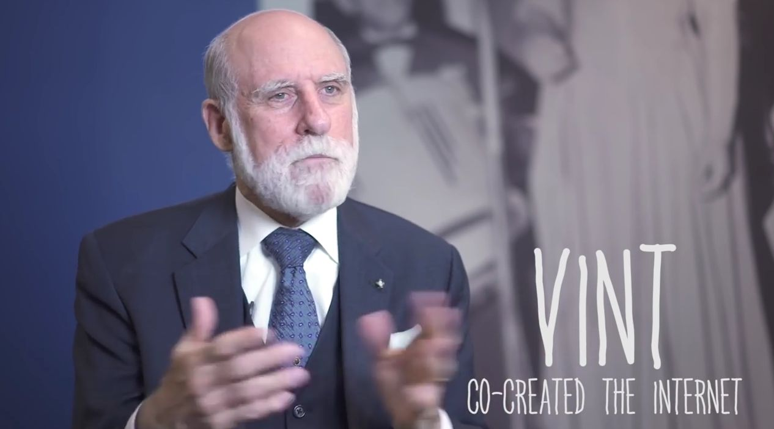
Video

Slide 8

IETF
In the video Vint Cerf says that nobody and everybody is in charge of making the internet work but the reason it all works together because everyone uses the same protocols
So who develops these protocols? Who makes the final decisions? Who is in charge? The amazing thing is that no single person, government, or corporation is in charge
Rather, it is a collection of citizens and volunteers interested in defining the standards who formed a volunteer organization called the Internet Engineering Task Force to develop and promote voluntary internet standards IETF

Slide 9
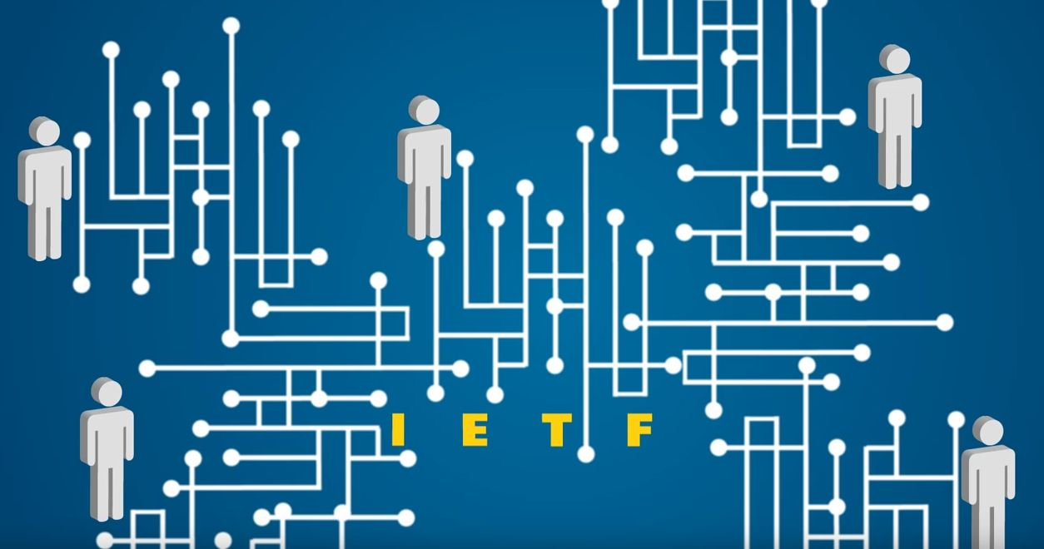
Introducing the Internet Engineering Task Force (IETF) - Making The Internet Work Better
Watch Video

Slide 10
Vint Cerf- Activity (1-2 People)
Handout- The Internet is for Everyone
In the memo, Vint Cerf lays out the state of the Internet and its usage in 2002
He predicts the future, and then presents a series of nine challenges or threats to the idea that the Internet is for everyone
With your partner or on your ow, pick one of the challenges that are the most meaningful to you, or relate to some experience you’ve had in your life
Create a Google Doc discussing 1 of the 9 Internet Challenges

Slide 11
Current Hot internet issues
Net Neutrality is a raging legal debate about the principle that Internet service providers should enable access to all content and applications regardless of the source, and without favoring or blocking particular products or websites.
Internet Censorship is the attempt to control or suppress of what can be accessed, published, or viewed on the Internet by certain people. This can be used to protect people (i.e. to not allow access to child pornography) but can also be used to limit free speech.

Slide 12
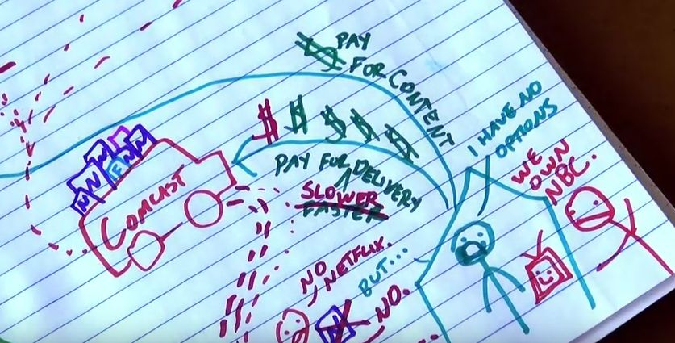
Video- Net Neutrality in the US: Now What?- 2014

Slide 13

Video- Will the End of Net Neutrality Be Bad for Gamers?- 2014

Slide 14

Review
The Internet is for Everyone
Next Class

